Slide 1
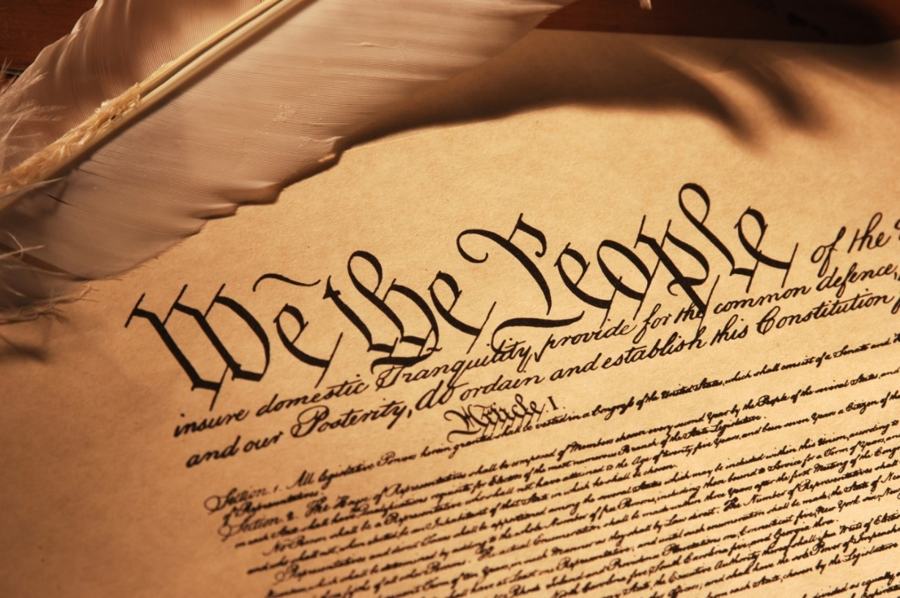
The U.S. Constitution
A Framework for Government

Slide 2
Question: Who here has read the Constitution?

Slide 3
The U.S. Constitution
Framework for government:
1. Limits on what gov’t can & can’t do
2. How to govern (implement politics)
3. “Changeable”
Notes:
I added the previous slide to emphasis an important point about a value of many people in the United States: CONSTITUTIONALISM
We often think of and discuss the constitution with reverential or almost religious terms: that it is perfect, that it is divine, that it is a testament to the brilliance of the Founding Fathers.
While we are certainly apt to praise the constitution for its longevity (its been around since 1787), its design is no accident; no divine interventional was necessary.

Slide 4
The U.S Constitution
Some nations lack a formal, written constitution [e.g., United Kingdom]
Oldest in world (c. 1789)
U.S. & the World has changed a lot in 236 years…
Notes:
I added the previous slide to emphasis an important point about a value of many people in the United States: CONSTITUTIONALISM
We often think of and discuss the constitution with reverential or almost religious terms: that it is perfect, that it is divine, that it is a testament to the brilliance of the Founding Fathers.
While we are certainly apt to praise the constitution for its longevity (its been around since 1787), its design is no accident; no divine interventional was necessary.

Slide 5
Debate: Open to Interpretation?
Vague & Brief
~ 8200 words
Not very specific about how the government should operate.
Notes:
I added the previous slide to emphasis an important point about a value of many people in the United States: CONSTITUTIONALISM
We often think of and discuss the constitution with reverential or almost religious terms: that it is perfect, that it is divine, that it is a testament to the brilliance of the Founding Fathers.
While we are certainly apt to praise the constitution for its longevity (its been around since 1787), its design is no accident; no divine interventional was necessary.

Slide 6
Debate: Open to Interpretation?
Durable
Amended 27 times; first 10 in 1791.
Only 17 amendments have been made since
Notes:
I added the previous slide to emphasis an important point about a value of many people in the United States: CONSTITUTIONALISM
We often think of and discuss the constitution with reverential or almost religious terms: that it is perfect, that it is divine, that it is a testament to the brilliance of the Founding Fathers.
While we are certainly apt to praise the constitution for its longevity (its been around since 1787), its design is no accident; no divine interventional was necessary.

Slide 7
Constitutionalism
“The Cult of the Constitution”
Was the U.S.C.
“inevitable and glorious?”
“No”
product of political bargaining & compromise
Notes:
I added the previous slide to emphasis an important point about a value of many people in the United States: CONSTITUTIONALISM
We often think of and discuss the constitution with reverential or almost religious terms: that it is perfect, that it is divine, that it is a testament to the brilliance of the Founding Fathers.
While we are certainly apt to praise the constitution for its longevity (its been around since 1787), its design is no accident; no divine interventional was necessary.

Slide 8
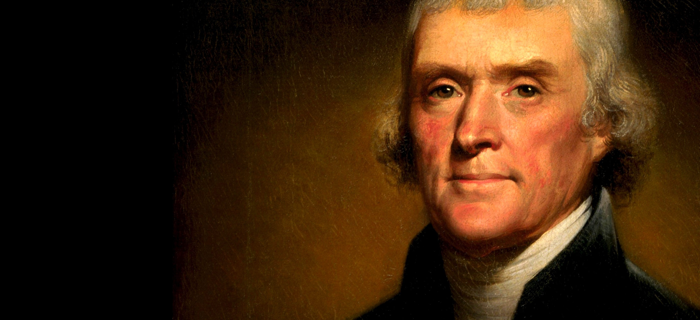
“…[Let us not] believe that one generation is not as capable as another of taking care of itself, and of ordering its own affairs …”
Notes:
“Some men look at constitutions with sanctimonious reverence, and deem them like the arc of the covenant, too sacred to be touched. They ascribe to the men of the preceding age a wisdom more than human, and suppose what they did to be beyond amendment … Let us follow no such examples, nor weakly believe that one generation is not as capable as another of taking care of itself, and of ordering its own affairs …”

Slide 9
Question: Do you Agree with Jefferson?

Slide 10
The constitution is a Framework for government
Legal & Institutional means for conducting politics

Slide 11


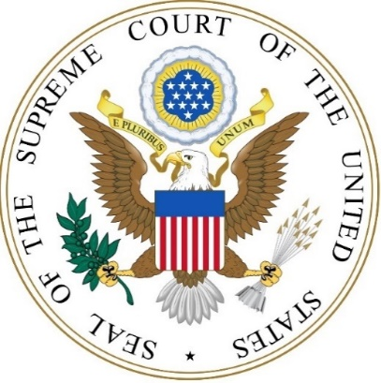
Framework for government
Mechanisms:
Fragmented institutions sharing power
(Divided Gov’t)
The three branches
(institutions)

Slide 12
Framework for government
Checks and balances
Exclusive (“enumerated”) powers
Shared powers
Checking powers

Slide 13
Congress
Economic: Raise taxes, borrow and mint money
Security: Declare war & raise army/navy
Necessary and Proper Clause (Elastic Clause)
Power of congress to pass all laws related to its expressed powers
Notes:
First branch; the most power.
Make laws; do what is necessary to support those laws.
Responsive and accountable to the states SENATE and the people HOUSE

Slide 14
Executive (President)
Commander-in-Chief of military
Diplomacy: receive ambassadors
Issue pardons (for Federal offences)
Execute/implement law (i.e., bureaucracy)

Slide 15
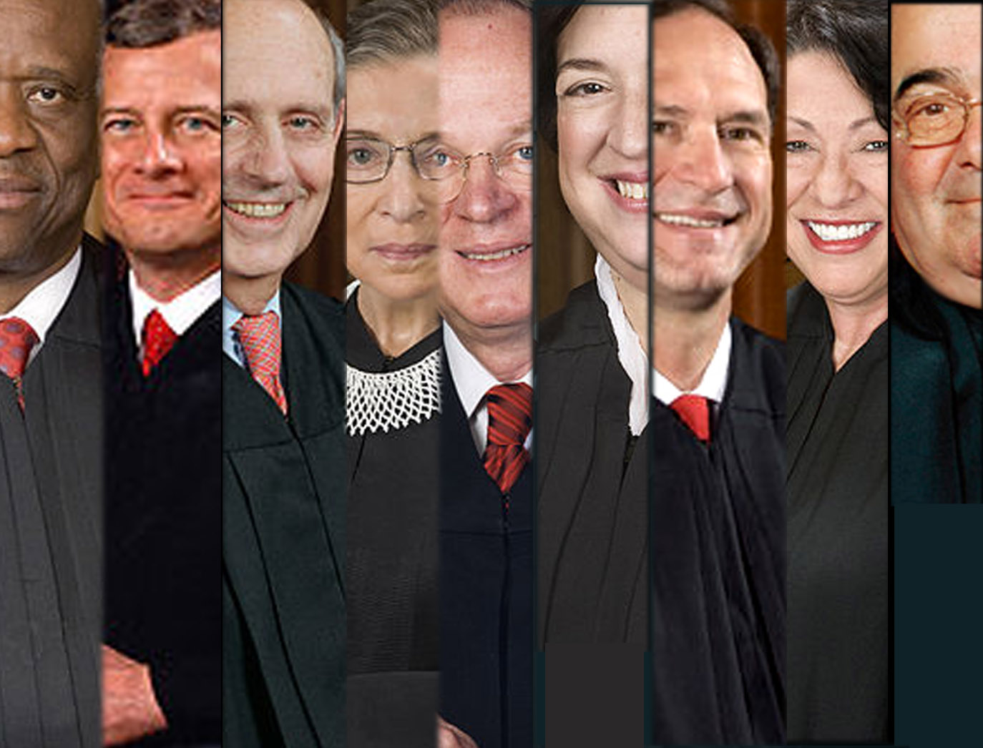
Courts/Judicial Branch
“Neither the power of the purse or the sword”
Lifetime tenure for Justices

Slide 16
Shared powers
Areas where no branch has exclusive control
Treaties (“advice and consent”)
War powers
Court Appointments
Notes:
War powers: congress can make war, but cannot declare war; President may send troops but not declare war
Court appointments: president nominates judges to SCOTUS; approved by congress

Slide 17
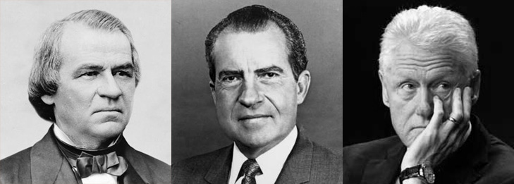
Checking (“negative”) Powers
Congress
Impeachment
Power of the purse
Sentencing guidelines
Override veto
Notes:
So no single branch dominates the national government
CONGRESS:
Impeachment: remove political officers (most notably the president) from office, but NOT for political reasons
Power of purse: congress can stop funding federal agencies; audit agencies to make sure money is being used appropriately
ONLY 2 presidents have been impeached: Johnson 17th and Clinton. Nixon was surely to be impeached. Both Johnson and Clinton were spared total impeachment by just a few votes in congress.

Slide 18
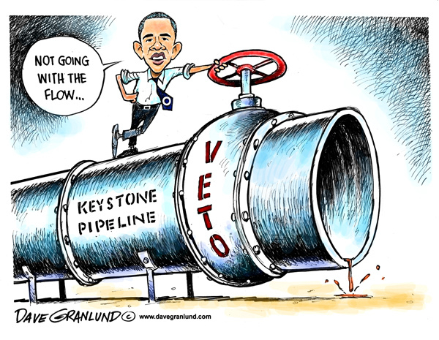
Checking (“negative”) Powers
President
Veto
Appoint federal judges
“Pack the court”
Notes:
Veto: used to stop a law from being passed. Provides a check on congressional power. Laws that the president does not support of find troublesome, they veto.

Slide 19
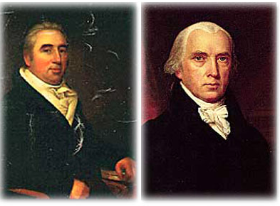
Checking (“negative”) Powers
Judicial Branch/The Court
Judicial review
Notes:
JR: strike down laws that it finds unconsititional
Not in the constitution; ca

Slide 20
HW Discussion
What problems or issue areas should government be responsible for?
Which issues should be left up to “the private sector”? Why or why not?

Slide 21
Historical Context
The Lead-up to the Constitution

Slide 22
Historical Context
Stamp Act (1765) → Unfair
Tea Act → Boston Tea Party → Coercive Acts
“No taxation without representation”
Why did the Colonists begin to advocate for “self rule”?
Notes:
The historical context is a good place to begin, as it allows us to understand why the framers decided to do what they did
Britian was imposing taxes and making laws that many colonists felt were unfair.
Radicalized the colonies to pursue independence
*It should be noted that at this stage (the lead-up to independence), there were already factions forming that would shape the outcome of the constitution
Merchants and shopkeepers allied with small farmers; the “professional class” (those with liscences from the Crown) were less adamant about the coming breakup with England

Slide 23
Factions
defined:
“groups of like-minded people who try to influence the government”
Minorities & Majorities
Notes:
*It should be noted that at this stage (the lead-up to independence), there were already factions forming that would shape the outcome of the constitution
Merchants and shopkeepers allied with small farmers; the “professional class” (those with liscences from the Crown) were less adamant about the coming breakup with England
James Madison, writing in The Federalist Papers, no. 10, speaks eloquently about the problem of factions. “A number of citizens, whether amounting to a majority or a minority of the whole, who are united and actuated by some common . . . interest, adverse to the rights of other citizens, or to the permanent and aggregate interests of the community.”
But what are factions? Factions are groups of like-minded people who try to influence the government. Often they try to dominate the government. American government is set up to avoid domination by any one of these groups.

Slide 24
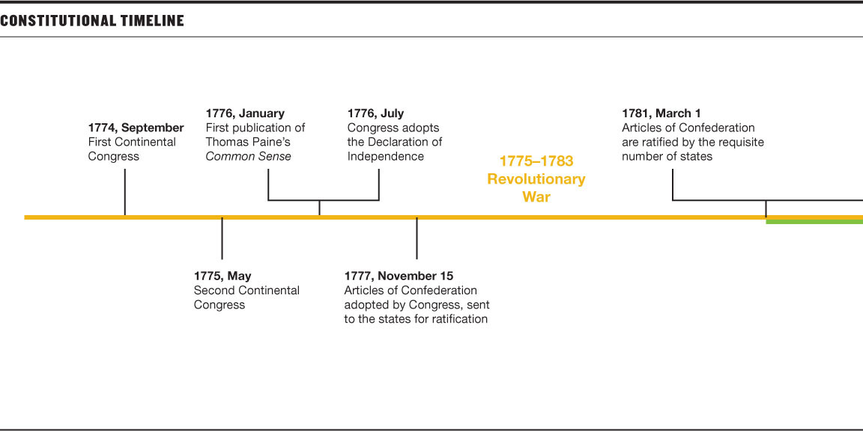

Slide 25
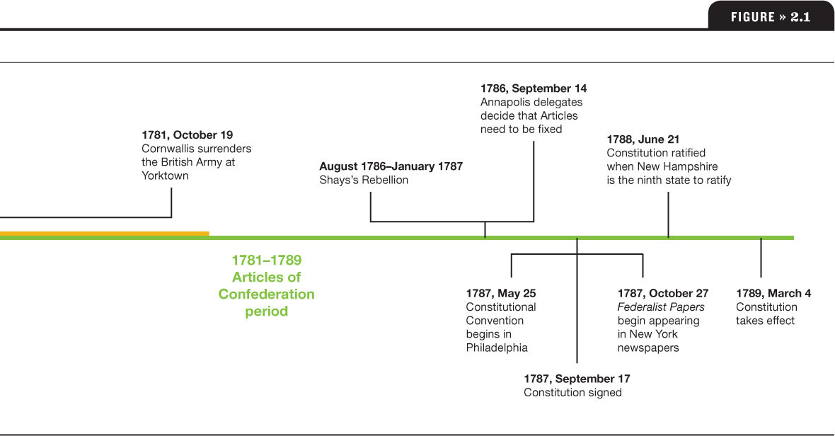

Slide 26
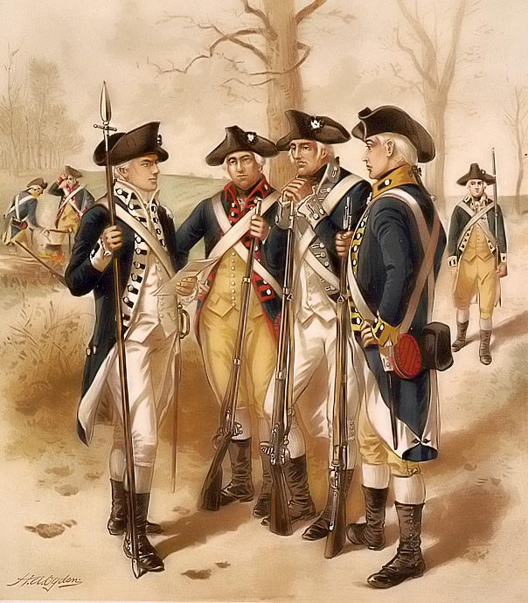
Historical context
“Now what do we do?”
Given the context of the Colonial period, what features/institutions would you want in your new government??
Notes:
In 1776, the same year that the continental congress approved the Declaration of Independence, the congress also drafted a
Document that would serve as the legal framework for the new nation’s politics. In other words, a blueprint for a government.
The state governments decided to use the Articles of Confederation, as it was the best they could come up with given the circumstances

Slide 27
The Articles of Confederation
Confederacy
defined:
System of government where states retain sovereignty except for powers expressly delegated to the national government
Limited Government
States [more power] >Federal Government
Notes:
The framers wanted to limit national government power. They had just come from a Monarchy and were very afraid that the new nation would fall to tyranny.
Colonies were now states; something akin to a country but all come from a similar background.
Drafters of the AOC wanted the states to retain their ability to make decisions and conduct their own affairs.
Weak national government; strong state governments.
>>>ASK: what are the roles of government.<<<
Limited Government is just that: the bare minimum. Prevent tyranny and protect property.
Today: the European Union; United Nations

Slide 28
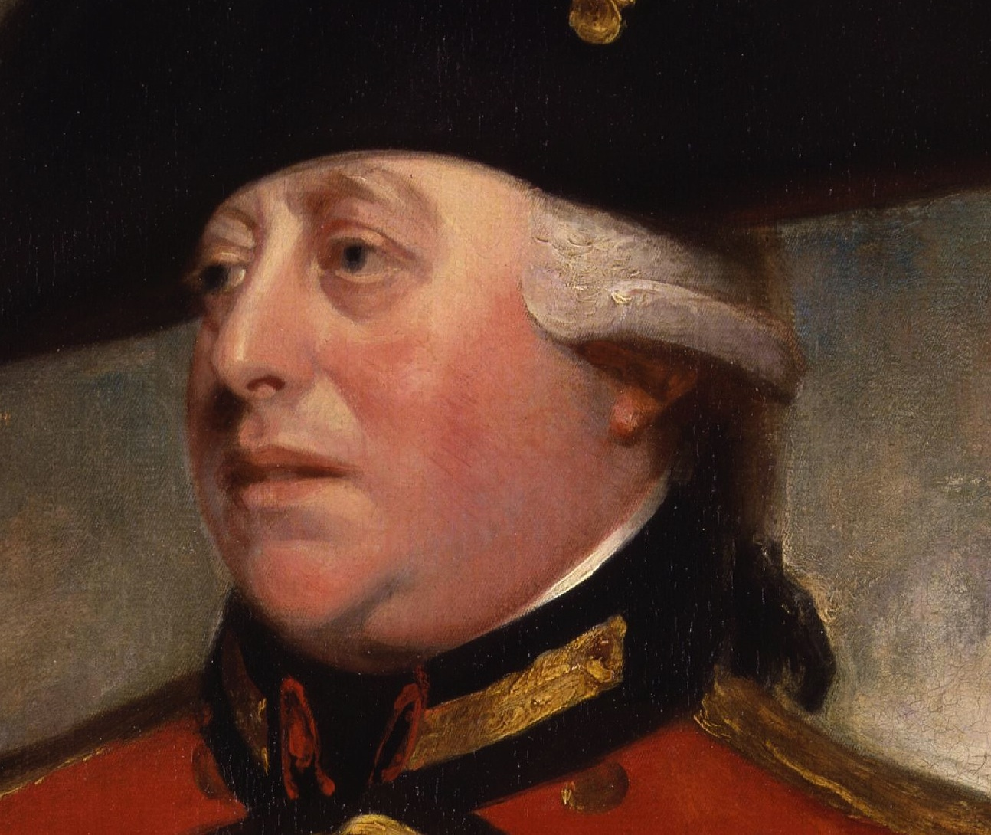
What Could the Federal Government Do Under the AOC?
“Oh hell no.”
Declare war
Conduct foreign affairs
Coin money
Regulate trade with Native Americans
Notes:
The idea of limited government was enshrined by the AOC.
Gov did not have much formal power. It could do many of the things we discussed last class: provide order and security….
But could it?
Discussing what the articles did is better suiting to what it DOES NOT do:
Declare war: most likely with England. Since the colonies did just declare independence and all.
Conduct foreign affairs: most likely to find some allies, you know, because England is the most powerful country in the world and you just pissed them off.
Coin money: to pay for this likely war with England and finance the state militias.
Regulate trade with Native Americans: or take their land, or whatever.

Slide 29
Issues at the forefront:
Complications & Omissions of the AOC
No way to collect or raise taxes
Both states and Federal government could make treaties
Unanimous ratification = minority power
Notes:
How do you pay for the war? There was effectively no way. The framers thought – very wrongly – that state governments would front the bill for both the revolutionary war and the re-pay the debts to foreign nations like France which helped the United States.
And any sort of trade agreement that would have benefitted the national government was
Unanimous revision: ALL 13 states had to vote YES on an amendment for it to be included (ratified) into the AOC. So if one small state decided that they didn’t like a new provision, then the whole operation shut down, despite the wishes of the other states.

Slide 30
Complications & Omissions of the AOC
No Executive
No Judicial branch
No unified system of money
No direct election of representatives
Issues in the Background:
Notes:
No Executive: founders wanted to prevent a monarchy at all cost; instead, all national power was derived from a Congress, where each state received one vote
Up to the states to ENFORCE laws
No Judiciary: legal matters would be left to the states.
No unified system of money: 13 colonies, with 13 forms of money

Slide 31
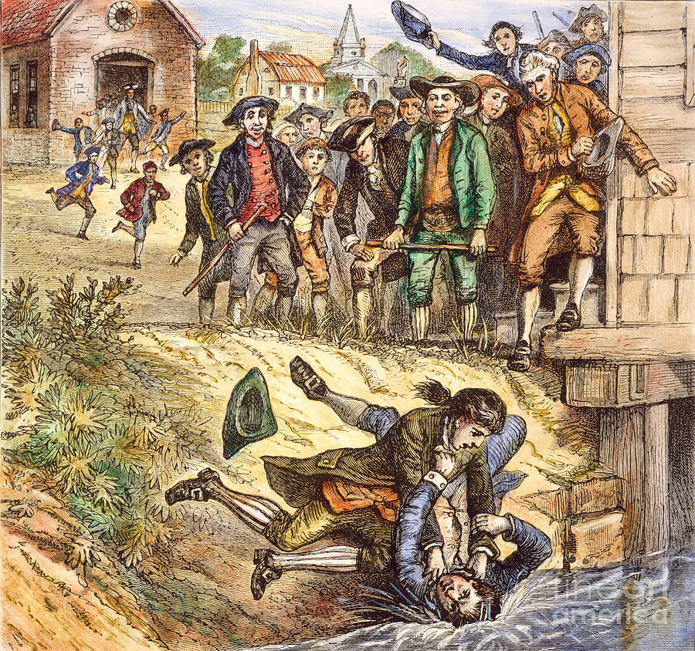
Revise the AOC?
Annapolis Convention 1786
(“The Procrastination Convention”)
Shay’s Rebellion
Exposes discontent with new government
Notes:
Many of the state governments were aware of the problems of the AOC. So state legislatures called for a convention to review the commerce and business aspects of the AOC. BUT: it was a dismal showing, and in the end the only outcome of the Annapolis convention was to postpone any further debate
Shay’s rebellion: former war general led a force of 1000 to take over the Massachusetts state government; recall that governments are needed to provide order
Goal was to stop state courts from porsecuting people in debt and taking their land
Other smaller rebellions took place in Penn and Virginia

Slide 32
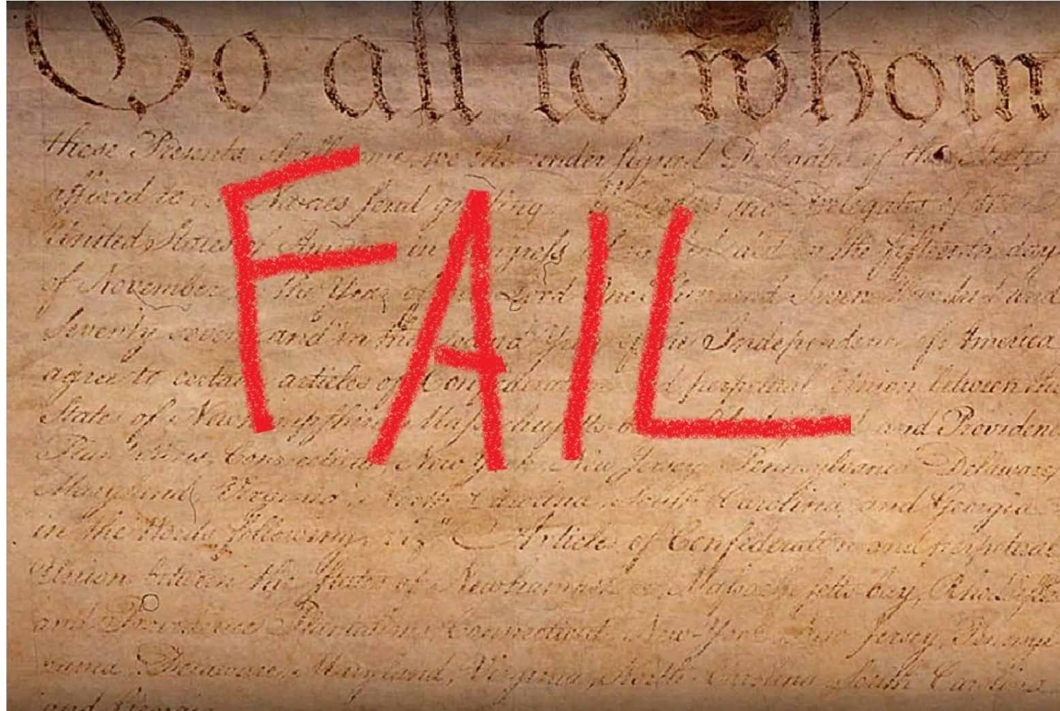
Revise the AOC? “NOPE.”
Notes:
Verdict: the AOC were not worth fixing.

Slide 33
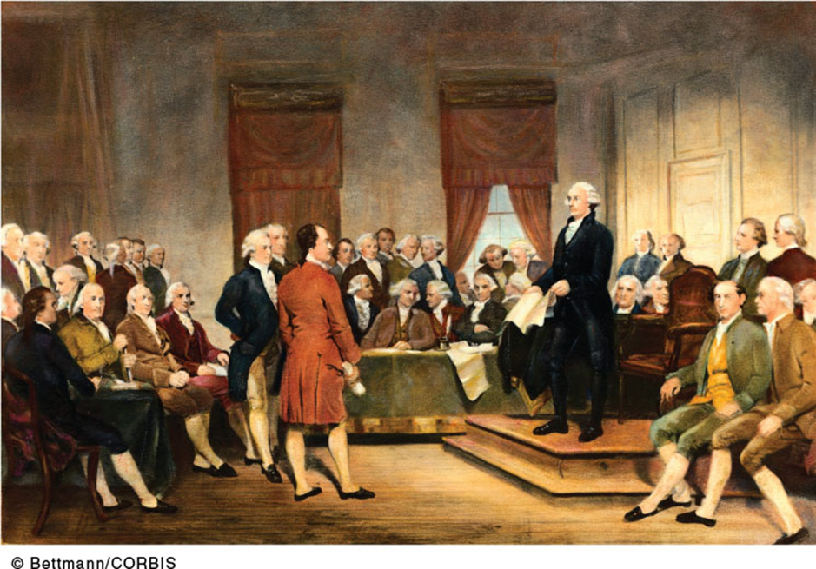
Answer: The Constitutional Conventional
Reality:
Scrap the AOC
Notes:
The constitution convention

Slide 34
Who are the Delegates at the Convention?
Representatives from each State
Goal: promote their state’s interest
Conflict Zone: 13 states, some alike, some different
Notes:
Ask the question.
TRANSITION → the Framers were tasked with sitting in a brick hall in Philadelphia with a looming deadline to either revise the AOC or scrap them.

Slide 35
Conflict and Compromise at the Convention
Constitution as product of political bargaining

Slide 36
What the Framers could agree on
1. Republicanism
2. Rejection of Monarchy
3. Limited Government
Politics: Conflict & Compromise
Bargaining – establish similarities
Notes:
Republicanism: interest of the people are represented through elected leaders (Framers found it to be the “best” at the time)
--Natural rights → those rights which a governments should strive to protect: life, liberty, pursuit of (property/happiness). A government that does not attempt to support these goals must go.
Framers came to the conclusion that the AOC did not adequately meet these ends (consent of the governed and protecting NATURAL RIGHTS).
--Consent of the governed → legitimacy of government through elections; ability for people to participate in elections
Reject Monarchy: during this period, the majority of governments around the world were monarchies. That’s all the framers knew.

Slide 37
1. Republicanism
Defined: Lawmaking via Representatives
Why?
People are Self-Interested (Factions)
Country is quite large.
Representative system
Channels Self-Interest through elected politicians
Notes:
James Madison, writing in The Federalist Papers, no. 10, speaks eloquently about the problem of factions. “A number of citizens, whether amounting to a majority or a minority of the whole, who are united and actuated by some common . . . interest, adverse to the rights of other citizens, or to the permanent and aggregate interests of the community.”
But what are factions? Factions are groups of like-minded people who try to influence the government. Often they try to dominate the government. American government is set up to avoid domination by any one of these groups.
Why do factions exist? Many reasons: differences of opinion, errors in reason, differences in wealth, property, native abilities; attachment to different leaders.
Madison saw two ways to eliminate the deleterious effects of factions, but only one that would work: Since “liberty is to faction as air is to fire,” one solution would be to eliminate liberty. This has obvious problems. A second way would be merely control factions by making sure that there were many of them and no one would grow too powerful—a powerful argument for creating a strong national government.
In Federalist 51, Madison eloquently states, “In framing a government which is to be administered by men over men, the great difficulty lies in this: you must first enable the government to control the governed; and in the next place oblige it to control itself.” The framers tried hard to harness humanity’s proclivities toward self-interest in the name of creating a more durable government.

Slide 38
2. Rejection of Monarchy
Why?
Revolutionary “Brexit”
Prevent absolute gov’t control
“Consent of the Governed” (Democracy)
Notes:
James Madison, writing in The Federalist Papers, no. 10, speaks eloquently about the problem of factions. “A number of citizens, whether amounting to a majority or a minority of the whole, who are united and actuated by some common . . . interest, adverse to the rights of other citizens, or to the permanent and aggregate interests of the community.”
But what are factions? Factions are groups of like-minded people who try to influence the government. Often they try to dominate the government. American government is set up to avoid domination by any one of these groups.
Why do factions exist? Many reasons: differences of opinion, errors in reason, differences in wealth, property, native abilities; attachment to different leaders.
Madison saw two ways to eliminate the deleterious effects of factions, but only one that would work: Since “liberty is to faction as air is to fire,” one solution would be to eliminate liberty. This has obvious problems. A second way would be merely control factions by making sure that there were many of them and no one would grow too powerful—a powerful argument for creating a strong national government.
In Federalist 51, Madison eloquently states, “In framing a government which is to be administered by men over men, the great difficulty lies in this: you must first enable the government to control the governed; and in the next place oblige it to control itself.” The framers tried hard to harness humanity’s proclivities toward self-interest in the name of creating a more durable government.

Slide 39
3. Limited Government
Why?
Prevent tyranny
Protect Economic Interests
Low inequality
Balance:
Free-trade & Regulation
Safeguards against gov’t
Notes:
Low Inequality: compared to Europe, the relative differences in wealth among the citizens of the US were low; so “political equality” as we understand it did not play a divisive role in the construction of the new constitution, but the protection of what property (wealth; land) those had played a part in the debates
Free-trade vs. Regulation: northern states enjoyed regulation and gov’t intervention when conducting commerce; southern farms wanted to make trade deals without intervention from the government
Strong National Government vs. Strong State governments

Slide 40
Result:
Revised Constitution would reflect these 3 values
Division on other issues generate conflict and factions
Notes:
Low Inequality: compared to Europe, the relative differences in wealth among the citizens of the US were low; so “political equality” as we understand it did not play a divisive role in the construction of the new constitution, but the protection of what property (wealth; land) those had played a part in the debates
Free-trade vs. Regulation: northern states enjoyed regulation and gov’t intervention when conducting commerce; southern farms wanted to make trade deals without intervention from the government
Strong National Government vs. Strong State governments

Slide 41
Factions at the convention
Federalists
Stronger national/federal Government
Concern:
AOC did not provide enough power to the national government
Antifederalists
Stronger state governments
Concern:
Fear of a all-powerful nat’l gov’t.
Notes:
The size and scope of state power was a part of nearly every debate at the Convention.

Slide 42
Major Conflicts at Convention
Majority rule
Large states
Legislative power
National
Slave states
minority rights
Small States
executive power
State (and local) power
non-slave states
VS.
Notes:
All these issues required compromise

Slide 43
Conflict & Compromise = Politics
Bargaining required
Why?
Overcome
CONFLICT
and facilitate COMPROMISE
Provisions of Constitution a result of political bargaining
NOT a result of enlightened guidance
Notes:
All these issues required compromise

Slide 44
Majority vs minority rights
Central problem for representative democracy:
protecting minority rights within a system of majority rule
Regional and economic minorities
Notes:
James madison argued that it is beneﬁcial to put the interests of one group in competition with the interests of other groups, so that no one group can dominate government. He hoped to achieve this through the separation of powers across different branches of the national government and across the national, state, and local levels.

Slide 45
Majority vs minority rights
Democratic Capture
Easier to avoid “minority tyranny”
Concern:
Minority interest might be “drowned” by chorus of majority
Harder to avoid “majority tyranny” in a democracy:
Concern:
Majority may not produce the common good

Slide 46
Small states vs. Large States
Recall: Republicanism →
Elected Citizens make laws on behalf other citizens
Legislature = Lawmaking Place (Congress!)
Key Issue
What are the “rules” [procedure] for sending Elected Representatives to the National Legislature?
Notes:
In the AOC, each state had the same vote and veto power in the national congress: one each. This cause “minority tyranny” or minority capture because states with the smallest populations OR a differing opinion about some topic or issue – taxation or trade protection, e.g – could shut down an amendment or law to the AOC

Slide 47
Small states vs. Large States
Issue w/AOC:
Unanimous voting =
minority tyranny
Large states: representation based on population
Small states: equal representation
Notes:
In the AOC, each state had the same vote and veto power in the national congress: one each. This cause “minority tyranny” or minority capture because states with the smallest populations OR a differing opinion about some topic or issue – taxation or trade protection, e.g – could shut down an amendment or law to the AOC

Slide 48
Small States vs. Large States
Virginia Plan
New Jersey Plan
rep based on population
strong national government
equal rep in national legislature
slightly weaker national government
Notes:
In the AOC, each state had the same vote and veto power in the national congress: one each. This cause “minority tyranny” or minority capture because states with the smallest populations OR a differing opinion about some topic or issue – taxation or trade protection, e.g – could shut down an amendment or law to the AOC
Note the the debate assumes a UNITARY CONGRESS, or a single house. One chamber where representatives would come together and make laws. This is the same as the AOC.
Virginia Plan – a plan proposed by the larger states during the Constitutional Convention in which representation in the national legislature was based on population. The plan also included a variety of other proposals to strengthen the national government.
New Jersey Plan – In response to the Virginia Plan, smaller states at the Constitutional Convention proposed that each state should receive equal representation in the national legislature, regardless of size.
Great Compromise – a compromise between the large and small states, proposed by Connecticut, in which Congress would have two houses: a Senate with two legislators per state and a House of Representatives in which each state’s representation would be based on population (also known as the Connecticut Compromise).

Slide 49
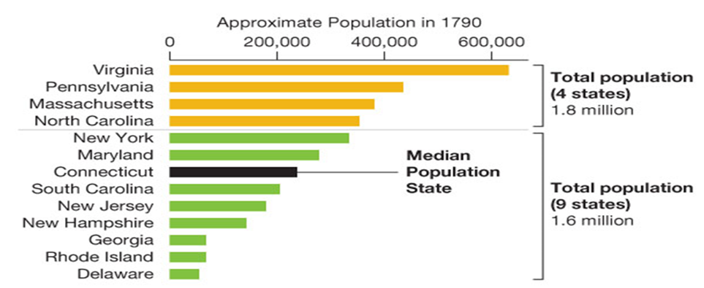
Small States vs. Large States

Slide 50
Small States vs. Large States
Compromise: “Great Compromise”
Bicameral legislature: Senate and House
House rep based on population
Senate rep equal (2 per state)
Notes:
Bicameral means 2 chambers in the lawmaking branch of government
One chamber, the house of representatives, would derive representation based on population
→ although CA didn’t exist, today it sends the most representatives to the House
Senate would mirror the AOC; send 2 Senators from each state

Slide 51
Legislative vs. Executive power
Key Issues:
Should the President be involved in lawmaking?
Who or what will ENFORCE or CARRY OUT the laws?
How do you stop a President from becoming a king?
Compromise:
Veto power gives President a significant role in lawmaking
Flexibility (prerogative powers) vs restraint (enumerated powers)
Notes:
The delegates to the convention knew what they did NOT want: a monarch. Thus, their first question they asked when coming up with the office of the presidency was “how much power should the executive branch have?”
Recall: the AOC did not offer an executive branch; enforcement of law was handled by each states
Some states advocated for a weaker presidency with easily overiddable veto power
Others suggested a “tribunal” of three executives that would enforce laws
Single executive with the power to veto a law passed by congress
Flexibility vs restraint: some delegates argued that a president needed to be able to respond to crises with flexibility – prerogative to act.
Others argued that the role of the president should be fully restrained; any powers delegated to the executive branch needed to be clearly spelled out, or enumerated, in the constitution

Slide 52
Choosing the President
“What Can We Use as a Model?”
Parliamentary? “No.”
Direct election by people? “No.”
Key Issues
How should the President be selected?
By popular vote or by “wise” statesmen?
Who is the President accountable to?
Notes:
Issue 2: Selecting the President
The Parliamentary system was the system that the Framers were familiar with. But many delegates did not want to
In such a system, the executive is chosen by the legislative branch
Delegates feared that the president would be beholden to congress if they went this route
Some delegates were also uncertain that the common citizen should be entrusted to make the decision on their own.

Slide 53
Compromise:
The Electoral College
“The People” do not elect the President
State committees (electors) casts a vote
Size of committee determined by population of each state
Choosing the President
Notes:
Issue 2: Selecting the President
The Parliamentary system was the system that the Framers were familiar with. But many delegates did not want to

Slide 54
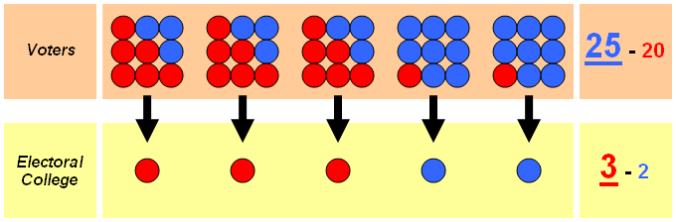
Electoral College
Serve as a “check” on popular vote
“An instrument of political parties”
Notes:
The core idea was that electors – wise and untainted by popular opinion – would make a sound and educated decision in any scenario.
In reality, the rise of political parties meant that electors would ultimately select the candidate of their party.

Slide 55
National vs. State/Local power
Compromise: FEDERALISM
Division of power between local, state, and national government
Reserved Powers
National Supremacy clause
Key Issues:
What do we do with the states?
Notes:
The size and scope of state power was a part of nearly every debate at the Convention.
Reserved Powers = powers not given to national government or not prohibited to the states are reserved to the states
Reserved Powers (see: Tenth Amendment)
Supremacy clause (see: Art. VI, sec. 2): if state and federal law are in conflict, national law take precedence

Slide 56
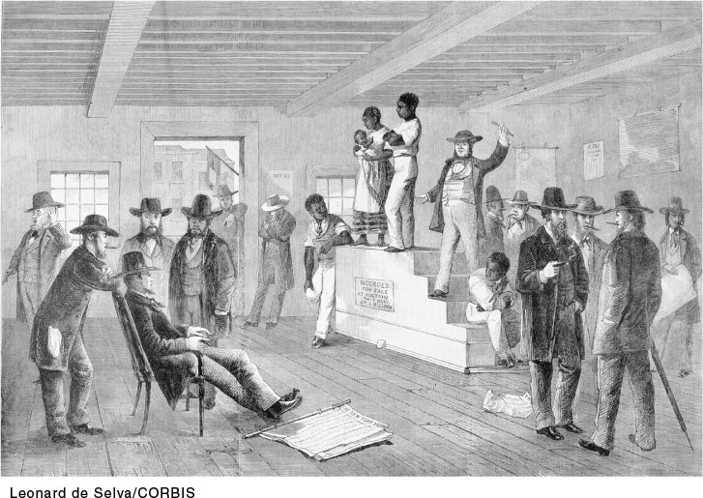
Slave states vs. Non-Slave
Key Issue
Should the US abolish slavery?
Are slaves people or property? – how to decide representation and taxation.
Notes:
A slave auction in Virginia. Slavery proved problematic at the Constitutional Convention: Would there be limits on the importation of slaves? How would runaway slaves be dealt with by non slave states? And how would slaves be counted for the purposes of congressional representation?
Non slave states obviously disliked the practice, but their delegates did not want to forfeit the entire convention by forcing the southern states to abandon the practice. Non slave states feared that the slave-holding states would exit the entire process.
It should come as no surprise that the SLAVE STATES were also the ones that generally supported LIMITED NATIONAL POWER and preferred a stronger role FOR THE STATES. After all, if the practice was legally prohibited by the constitution, it would destroy the ecomonic and social system of the south as they understood it.

Slide 57
Slave states vs. Non-Slave
Slavery as a bargaining tool, not a moral question
→Three-fifths Compromise
Slaves would count as 3/5 of a person for purposes of determining taxation & representation
→(S) Fugitive Slave Clause ← → (N) Easier to pass taxes
→Slavery legally closed from discussion until 1808
Notes:
Slave states wanted their slaves to count as a WHOLE PERSON for purposes of representation…the more slaves, the more power and more representatives they could send to congress
NonSlave obviously did not approve, noting that slaves were property by the very definition that the slave states used
Fugitive slave clause: north agreed to return runaway slaves in exchange for the southern states accepting trade regulations that were desired, but not included, in the AOC
Some observers of the Philadelphia Convention argue that the authors of the Constitution failed their country by failing to outlaw slavery in 1787. Others claim that the Constitution would never have been ratified if slavery had not remained legal. What do you think? Did the framers of the Constitution fail or did they do the best they could, given the circumstances?

Slide 58
Question
Some observers of the Philadelphia Convention argue that the authors of the Constitution failed their country by failing to outlaw slavery in 1787. Others claim that the Constitution would never have been ratified if slavery had not remained legal.
What do you think? Did the framers of the Constitution fail or did they do the best they could, given the circumstances?

Slide 59
Ratification: Making it the law
Supermajority: 9 states only, not all
The Bill of Rights
→First 10 Amendments
→protect individual rights and liberties
→secure votes from uncertain states
Notes:
The Bill of Rights helped to calm the fears of the antifederalists: those framers who were suspicious of too much national power at the expense of states rights
Bill of rights were not necessarily going to be added. They are the cornerstone of the constitution but they
Many states were hesistant to ratifiy the constitution despite the compromises.

Slide 60
HW Discussion
What provisions, if anything, would you include from the SA constitution in a revised US Bill of Rights? Why?
What, if anything, do you feel is unnecessary about the SA Bill of Rights? In other words, what could be removed from it?
Notes:
The Bill of Rights helped to calm the fears of the antifederalists: those framers who were suspicious of too much national power at the expense of states rights
Bill of rights were not necessarily going to be added. They are the cornerstone of the constitution but they
Many states were hesistant to ratifiy the constitution despite the compromises.

Slide 61
Why has the Constitution remained relevant for over 200 years?

Slide 62
3 reasons why the constitution is likely to remain the framework for united states government
Ambiguity
Amendment process
Multiple interpreters
Notes:
Ambiguity – general language and “ “ has allowed it to evolve
Executive power clause – “executive power is vested in the President”
Commerce clause: allows congress to regulate interstate commerce; today serves as the basis for much of the laws passed

Slide 63
1. ambiguity
General language
Necessary and proper clause
Executive powers clause
Commerce clause
Notes:
Ambiguity – general language and “ “ has allowed it to evolve
Executive power clause – “executive power is vested in the President” what is executive power, anyway?
Commerce clause: allows congress to regulate interstate commerce; today serves as the basis for much of the laws passed

Slide 64
2. Changing the constitution
Proposal
2/3 of Congress
2/3 of State legislatures/State “convention”
Ratification & Adoption
¾ of State legislatures
¾ of State conventions
Notes:
The Framers were not ignorant. Clearly. So they included provisions for changing the constitution through the formal amendment process.
Note that this is a very difficult process with a high failure rate.

Slide 65
2. Changing the constitution
~200 proposed per session of Congress
~10,000 proposed since 1787
~only 27 made it through process since 1787
What does this tell you about the process?

Slide 66
2. Changing the constitution
Amendment overview
Liberty (1, 2, 3)
Justice (4, 5, 6, 7, 8)
Unenumerated rights and reserved powers (9, 10)
Governmental authority (11, 16, 18, 21)
Civil rights (13, 14, 15, 19, 23, 24, 26)
Processes and Procedures (12, 17, 20, 22, 25, 27)

Slide 67
3. Multiple interpreters
Implied powers: derived, but not stated
President and Supreme Court are most active interpreters
8th amendment: “Executing Horse thieves and children?”
Notes:
Implied powers: powers, rules, and norms derived from the document; most notably through the decisions of the supreme court, but also by the other branches
Lincoln rested on the “implied powers” of the executive branch to make critical decisions during the civil war
No cruel and unusual punishment?

Slide 68
Questions
If you could make one change to the Constitution, what would it be? Why?
How likely do you think that your amendment would be ratified? Why?
Given how different our society is today as compared to 1787, do you think the Constitution can survive another 200 years? Why or why not?

